Slide 1
CS4038
DATA MINING
LECTURE # 10
SPRING 2024
FAST – NUCES, CFD CAMPUS
AYESHA LIAQAT
ayesha.liaqat@nu.edu.pk

Slide 2
TODAY’S TOPICS
Rule-based classifier
Application of rule-based classifier
Rule quality: coverage and accuracy
Mutually exclusive and exhaustive rules
Learning rules: direct and indirect methods

Slide 3
RULE-BASED CLASSIFIER
Classify records by using a collection of “if…then…” rules
Rule: (Condition) → y
where
Condition is a conjunction of tests on attributes(precondition/antecedent)
y is the class label(consequent)
Examples of classification rules:
(Blood Type=Warm) ∧ (Lay Eggs=Yes) → Birds
(Taxable Income < 50K) ∧ (Refund=Yes) → Evade=No

Slide 4
RULE-BASED CLASSIFIER (EXAMPLE)
Name | Blood Type | Give Birth | Can Fly | Live in Water | Class
human | warm | yes | no | no | mammals
python | cold | no | no | no | reptiles
salmon | cold | no | no | yes | fishes
whale | warm | yes | no | yes | mammals
frog | cold | no | no | sometimes | amphibians
komodo | cold | no | no | no | reptiles
bat | warm | yes | yes | no | mammals
pigeon | warm | no | yes | no | birds
cat | warm | yes | no | no | mammals
leopard shark | cold | yes | no | yes | fishes
turtle | cold | no | no | sometimes | reptiles
penguin | warm | no | no | sometimes | birds
porcupine | warm | yes | no | no | mammals
eel | cold | no | no | yes | fishes
salamander | cold | no | no | sometimes | amphibians
gila monster | cold | no | no | no | reptiles
platypus | warm | no | no | no | mammals
owl | warm | no | yes | no | birds
dolphin | warm | yes | no | yes | mammals
eagle | warm | no | yes | no | birds
R1: (Give Birth = no) ∧ (Can Fly = yes) → Birds
R2: (Give Birth = no) ∧ (Live in Water = yes) → Fishes
R3: (Give Birth = yes) ∧ (Blood Type = warm) → Mammals
R4: (Give Birth = no) ∧ (Can Fly = no) → Reptiles R5: (Live in Water = sometimes) → Amphibians
4

Slide 5
APPLICATION OF RULE-BASED CLASSIFIER
R1: (Give Birth = no) ∧ (Can Fly = yes) → Birds
R2: (Give Birth = no) ∧ (Live in Water = yes) → Fishes
R3: (Give Birth = yes) ∧ (Blood Type = warm) → Mammals R4: (Give Birth = no) ∧ (Can Fly = no) → Reptiles
R5: (Live in Water = sometimes) → Amphibians
A rule r covers an instance x if the attributes of the instance satisfy the condition (or antecedent) of the rule
Name | Blood Type | Give Birth | Can Fly | Live in Water | Class
hawk | warm | no | yes | no | ?
grizzly bear | warm | yes | no | no | ?
The rule R1 covers a hawk => Bird
The rule R3 covers the grizzly bear => Mammal
5

Slide 6


RULE COVERAGE AND ACCURACY
Coverage of a rule:
Fraction of records that satisfy the antecedent of a rule
Tid | Refund | Marital Status | Taxable Income | Class
1 | Yes | Single | 125K | No
2 | No | Married | 100K | No
3 | No | Single | 70K | No
4 | Yes | Married | 120K | No
5 | No | Divorced | 95K | Yes
6 | No | Married | 60K | No
7 | Yes | Divorced | 220K | No
8 | No | Single | 85K | Yes
9 | No | Married | 75K | No
10 | No | Single | 90K | Yes
Accuracy of a rule:
Fraction of records that satisfy the antecedent that also satisfy the consequent of a rule
10
Example: (Status=Single) → No
6
Coverage = 40%, Accuracy = 50%
Notes:
Quality of classification rules using coverage and accuracy.
R: A--→ Y, cov= |A| / |D| , acc= |A ∩ Y | / |D|

Slide 7
PRACTICE WORK
R1: (Give Birth = no) ∧ (Can Fly = yes) → Birds
R2: (Give Birth = no) ∧ (Live in Water = yes) → Fishes
R3: (Give Birth = yes) ∧ (Blood Type = warm) → Mammals R4: (Give Birth = no) ∧ (Can Fly = no) → Reptiles
R5: (Live in Water = sometimes) → Amphibians
Identify the rule(s) which cover the following instances.
Name | Blood Type | Give Birth | Can Fly | Live in Water | Class
lemur | warm | yes | no | no | ?
turtle | cold | no | no | sometimes | ?
dogfish shark | cold | yes | no | yes | ?
A lemur triggers rule R3, so it is classified as a mammal A turtle triggers both R4 and R5
A dogfish shark triggers none of the rules

Slide 8
CHARACTERISTICS OF RULE SETS: STRATEGY 1
Mutually exclusive rules
Classifier contains mutually exclusive rules if the rules are independent of each other
Every record is covered by at most one rule
Exhaustive rules
Classifier has exhaustive coverage if it accounts for every possible combination of attribute values
Each record is covered by at least one rule

Slide 9
CHARACTERISTICS OF RULE SETS: STRATEGY 2
Rules are not mutually exclusive
A record may trigger more than one rule
Solution?
Use a conflict resolution strategy
Unordered rule set – use voting schemes
Ordered rule set
Size ordering
Rules are not exhaustive
A record may not trigger any rules
Solution?
Use a default class
Notes:
Unordered rules may use the vote weighted by rule’s accuracy. R1 triggered by r1,r2,r3,r4 and labels are A,B,A,A so votes of A are more.

Slide 10
SIZE ORDERING
Size ordering assigns the highest priority to the triggering rule that has the “toughest” requirements.
Toughness is measured by the rule antecedent size.
That is, the triggering rule with the most attribute tests is fired.

Slide 11
ORDERED RULE SET
Rules are ranked/ordered beforehand according to their priority
An ordered rule set is known as a decision list
When a test record is presented to the classifier
It is assigned to the class label of the highest ranked rule it has triggered
R1: (Give Birth = no) ∧ (Can Fly = yes) → Birds
R2: (Give Birth = no) ∧ (Live in Water = yes) → Fishes
R3: (Give Birth = yes) ∧ (Blood Type = warm) → Mammals R4: (Give Birth = no) ∧ (Can Fly = no) → Reptiles
R5: (Live in Water = sometimes) → Amphibians
Name | Blood Type | Give Birth | Can Fly | Live in Water | Class
turtle | cold | no | no | sometimes | ?
Notes:
Priority may be accuracy, coverage, length, order in which rules are generated.

Slide 12
RULE ORDERING SCHEMES
Rule-based ordering
Individual rules are ranked based on their quality (e.g., accuracy, coverage, size, etc.)
Class-based ordering
Rules that belong to the same class appear together
All the rules for the most prevalent (or most frequent) class come first, the rules for the next prevalent class come next, and so on.
Rule-based Ordering
(Refund=Yes) ==> No
(Refund=No, Marital Status={Single,Divorced},
Taxable Income<80K) ==> No
(Refund=No, Marital Status={Single,Divorced},
Taxable Income>80K) ==> Yes
(Refund=No, Marital Status={Married}) ==> No
Class-based Ordering
(Refund=Yes) ==> No
(Refund=No, Marital Status={Single,Divorced},
Taxable Income<80K) ==> No
(Refund=No, Marital Status={Married}) ==> No
(Refund=No, Marital Status={Single,Divorced}, Taxable Income>80K) ==> Yes
12
Rule-based classifiers mostly use class-based ordering

Slide 13
DEFAULT RULE
If none of the rules fired, it is assigned to the default class.
This may be the class in majority.
Or majority class of the tuples that were not covered by any rule.
Default rule is evaluated at the end, if and only if no other rule covers X.
Condition in the default rule is empty.
Example:
{ } → No

Slide 14
BUILDING CLASSIFICATION RULES

Slide 15
BUILDING CLASSIFICATION RULES
Direct Method:
Extract rules directly from data
Examples: RIPPER, CN2, Holte’s 1R
Indirect Method:
Extract rules from other classification models (e.g., decision trees, neural networks, etc.).
Examples: C4.5rules

Slide 16
EXAMPLE: INDIRECT METHOD
LEARNING RULES FROM A DECISION TREE
Rules set:
R1: if (age <= 30) and (student=no) then (buys_computer=no)
R2: if (age <= 30) and (student=yes) then (buys_computer=yes)
And so on…
age?
<=30
overcast
>40
31..40
student?
yes
credit rating?
no
yes
excellent
fair
no
yes
no
yes
Rules extracted from a decision tree will be mutually exclusive and exhaustive.

Slide 17
SEQUENTIAL COVERING METHOD
RULE INDUCTION: DIRECT METHOD

Slide 18
RULE INDUCTION: SEQUENTIAL COVERING METHOD
Sequential covering algorithm: Extracts rules directly from training data
Typical sequential covering algorithms: FOIL, AQ, CN2, RIPPER
Rules are learned sequentially, each for a given class C_{i} will cover many tuples of C_{i} but none (or few) of the tuples of other classes
Steps:
Rules are learned one at a time
Each time a rule is learned, the tuples covered by the rules are removed
Repeat the process on the remaining tuples until termination condition, e.g., when no more training examples or when the quality of a rule returned is below a user-specified threshold
Notes:
Rules learned for one class first and then for 2nd class and then for 3rd class. Which class should be learned first? Factors like i) class prevalence ii) cost of misclassifying records for a given class.

Slide 19
EXAMPLE OF SEQUENTIAL COVERING
Rule Induction Steps:
Rules are learned one at a time
Each time a rule is learned, the tuples covered by the rules are removed
Repeat the process on the remaining tuples until termination condition, e.g., when no more training examples or when the quality of a rule returned is below a user-specified threshold
R1
R1
R2
(i) Original Data
(ii) Step 1
(iii) Step 2
(iv) Step 3

Slide 20

SEQUENTIAL COVERING ALGORITHM
while (enough target tuples left) generate a rule
remove positive target tuples satisfying this rule
Examples covered
by Rule 2
Examples covered by Rule 3
Examples covered by Rule 1
Positive examples

Slide 21
DIRECT METHOD: SEQUENTIAL COVERING
Start from an empty rule
Grow a rule using the Learn-One-Rule function
Remove training records covered by the rule
Repeat Step (2) and (3) until stopping criterion is met
Repeat the process on the remaining tuples until termination condition, e.g., when no more training examples or when the quality of a rule returned is below a user-specified threshold
Notes:
a predefined stopping criterion is met (e.g., maximum number of rules, minimum accuracy threshold).

Slide 22
HOW TO LEARN-ONE-RULE?
Start with the most general rule possible
condition = empty (r : { } → y})
Adding new attributes by adopting a greedy depth-first strategy
Picks the one that most improves the rule quality
favors rules that have high accuracy and cover many positive tuples

Slide 23
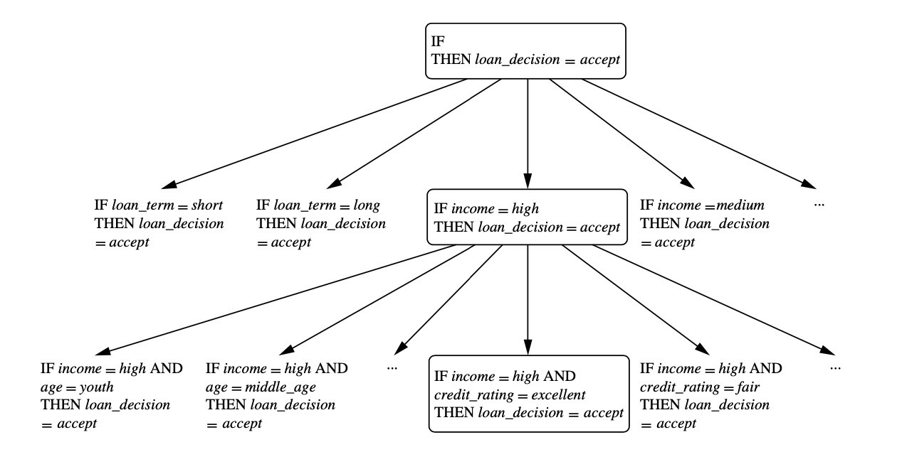
DIRECT METHOD: SEQUENTIAL COVERING

Slide 24
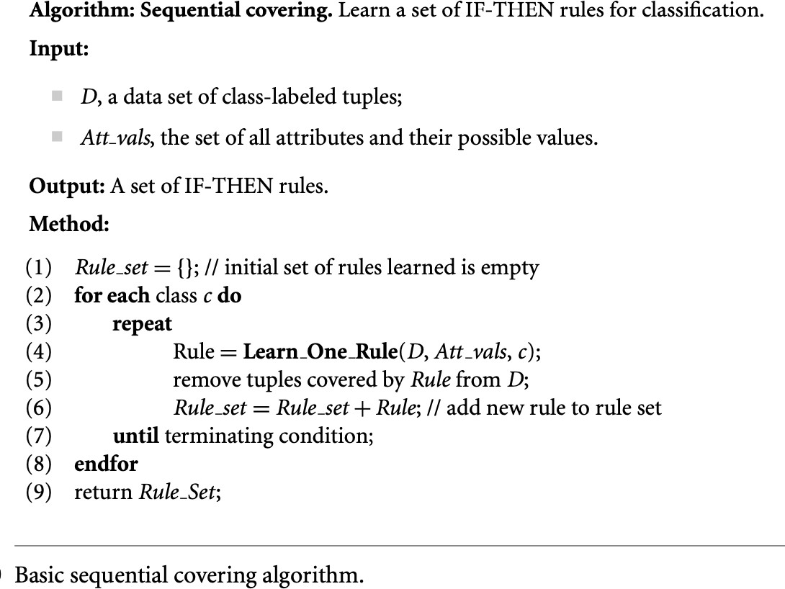
DIRECT METHOD: SEQUENTIAL COVERING

Slide 25
ASPECTS OF SEQUENTIAL COVERING
Rule growing
Instance elimination
Rule evaluation
Stopping criterion
Rule pruning

Slide 26
READING MATERIAL
Chapter 4:Tan, Steinbach & Kumar
Chapter 8: Han, Kamber & Pei
34

